Slide 1

Exploratory Data Analysis (EDA) - Bank Dataset
Statistical Learning & Data Analysis
Master in Data Science
Department of Engineering
Prepared by :
Shurouq Abuewaili
Mona AlRozzi
Mahmoud Nweija
Supervised by :
Prof.Roberta Siciliano
Prof.Emiliano Del Gobbo

Slide 2

Project Objective
Perform a complete Exploratory Data Analysis (EDA).
Understand the structure and main characteristics of the dataset.
Identify relationships and patterns among variables.
Apply PCA and Clustering to explore data structure

Slide 3
TABLE OF CONTENTS
01
03
02
04
Data Description
Principal Component Analysis (PCA)
Univariate Analysis: Numerical Variables
Conclusion

Slide 4
01
Dataset Description

Slide 5
Dataset Description
The dataset contains information about bank clients and marketing campaign outcomes.
Number of observations: 45,211
Number of variables: 17
Target variable: y (subscription to term deposit)

Slide 6
Variables Overview
Categorical |  | Numerical
job | month | age
marital | poutcome | balance
education | y | day
default |  | duration
housing |  | campaign
loan |  | pdays
contact |  | previous

Slide 7
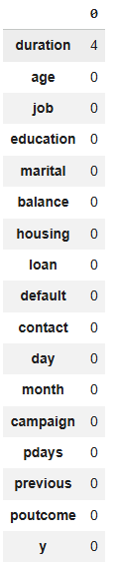
Data Cleaning
Missing Data
Missing values handled through:
Remove rows with null values.
Imputation by mean value.
Duplicated values
No duplicated observations detected

Slide 8
02
Univariate Analysis: Numerical Variables

Slide 9
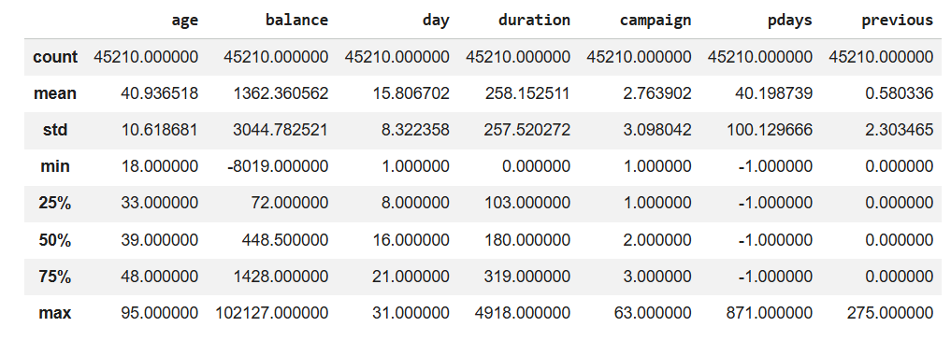
Descriptive Statistics
Notes:
The key impressions and findings for each numeric variable:
age: The average age is around 40.9 years, with a standard deviation of 10.6. Ages range from 18 to 95. The median (39) is close to the mean, suggesting a relatively symmetrical distribution with a slight right skew, as 75% of the data is below 48.
balance: This variable shows a wide range from -8019 to 102127, indicating that some clients have negative balances (overdrafts) and a few have extremely high balances. The mean balance is 1362, but the median is much lower at 448.5, and the standard deviation is very high (3044.78). This confirms a strong right-skewed distribution, with most clients having lower balances and a few outliers with very large balances.
day: The average day of contact is around the 15th or 16th of the month. The distribution seems fairly uniform across the month, with a range from day 1 to 31.
duration: The average contact duration is about 258 seconds (around 4.3 minutes), but the standard deviation is almost as large as the mean (257.5), and the median is 180 seconds. The maximum duration is 4918 seconds (over 81 minutes). This suggests a heavily right-skewed distribution, with most contacts being short and a few being very long.
campaign: On average, clients are contacted 2.76 times. The minimum is 1 contact and the maximum is 63. The median is 2. The distribution is highly right-skewed, indicating that most clients are contacted only a few times, while a small number are contacted many times.
pdays: The mean pdays is about 40.2, but the median is -1. The value -1 typically signifies that the client was not previously contacted. A large portion of the data is concentrated at -1, with the remaining positive values ranging up to 871. This variable is heavily skewed towards -1, with a long tail for clients who were contacted in previous campaigns.
previous: The average number of previous contacts is very low (0.58), with a median of 0. The maximum is 275. This variable is also highly right-skewed, showing that most clients have had no previous contacts, and a few have had many.
In summary, balance, duration, campaign, pdays, and previous all exhibit strong positive skewness, indicating the presence of outliers or a distribution where a large number of observations are concentrated at the lower end, with a few extreme values at the higher end. Age is relatively more symmetrical but still slightly right-skewed, while day appears to be more uniformly distributed.

Slide 10
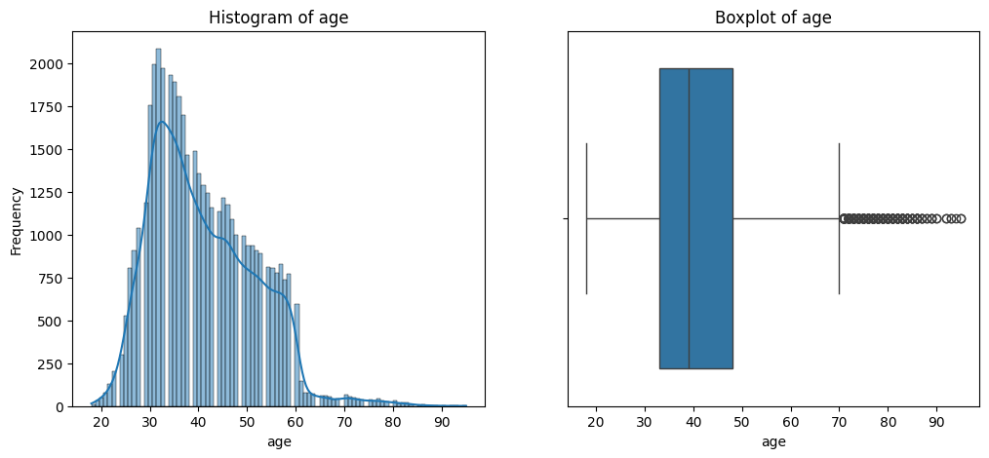
Age distribution
Notes:
The key impressions and findings for each numeric variable:
age: The average age is around 40.9 years, with a standard deviation of 10.6. Ages range from 18 to 95. The median (39) is close to the mean, suggesting a relatively symmetrical distribution with a slight right skew, as 75% of the data is below 48.
balance: This variable shows a wide range from -8019 to 102127, indicating that some clients have negative balances (overdrafts) and a few have extremely high balances. The mean balance is 1362, but the median is much lower at 448.5, and the standard deviation is very high (3044.78). This confirms a strong right-skewed distribution, with most clients having lower balances and a few outliers with very large balances.
day: The average day of contact is around the 15th or 16th of the month. The distribution seems fairly uniform across the month, with a range from day 1 to 31.
duration: The average contact duration is about 258 seconds (around 4.3 minutes), but the standard deviation is almost as large as the mean (257.5), and the median is 180 seconds. The maximum duration is 4918 seconds (over 81 minutes). This suggests a heavily right-skewed distribution, with most contacts being short and a few being very long.
campaign: On average, clients are contacted 2.76 times. The minimum is 1 contact and the maximum is 63. The median is 2. The distribution is highly right-skewed, indicating that most clients are contacted only a few times, while a small number are contacted many times.
pdays: The mean pdays is about 40.2, but the median is -1. The value -1 typically signifies that the client was not previously contacted. A large portion of the data is concentrated at -1, with the remaining positive values ranging up to 871. This variable is heavily skewed towards -1, with a long tail for clients who were contacted in previous campaigns.
previous: The average number of previous contacts is very low (0.58), with a median of 0. The maximum is 275. This variable is also highly right-skewed, showing that most clients have had no previous contacts, and a few have had many.
In summary, balance, duration, campaign, pdays, and previous all exhibit strong positive skewness, indicating the presence of outliers or a distribution where a large number of observations are concentrated at the lower end, with a few extreme values at the higher end. Age is relatively more symmetrical but still slightly right-skewed, while day appears to be more uniformly distributed.

Slide 11
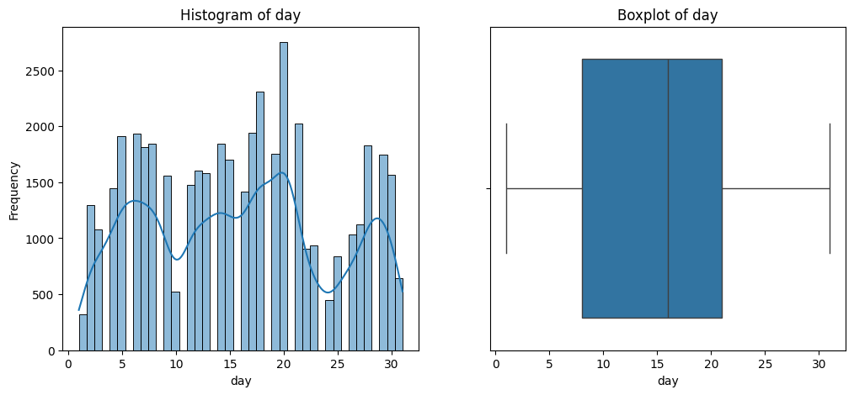
Day distribution
Notes:
The key impressions and findings for each numeric variable:
age: The average age is around 40.9 years, with a standard deviation of 10.6. Ages range from 18 to 95. The median (39) is close to the mean, suggesting a relatively symmetrical distribution with a slight right skew, as 75% of the data is below 48.
balance: This variable shows a wide range from -8019 to 102127, indicating that some clients have negative balances (overdrafts) and a few have extremely high balances. The mean balance is 1362, but the median is much lower at 448.5, and the standard deviation is very high (3044.78). This confirms a strong right-skewed distribution, with most clients having lower balances and a few outliers with very large balances.
day: The average day of contact is around the 15th or 16th of the month. The distribution seems fairly uniform across the month, with a range from day 1 to 31.
duration: The average contact duration is about 258 seconds (around 4.3 minutes), but the standard deviation is almost as large as the mean (257.5), and the median is 180 seconds. The maximum duration is 4918 seconds (over 81 minutes). This suggests a heavily right-skewed distribution, with most contacts being short and a few being very long.
campaign: On average, clients are contacted 2.76 times. The minimum is 1 contact and the maximum is 63. The median is 2. The distribution is highly right-skewed, indicating that most clients are contacted only a few times, while a small number are contacted many times.
pdays: The mean pdays is about 40.2, but the median is -1. The value -1 typically signifies that the client was not previously contacted. A large portion of the data is concentrated at -1, with the remaining positive values ranging up to 871. This variable is heavily skewed towards -1, with a long tail for clients who were contacted in previous campaigns.
previous: The average number of previous contacts is very low (0.58), with a median of 0. The maximum is 275. This variable is also highly right-skewed, showing that most clients have had no previous contacts, and a few have had many.
In summary, balance, duration, campaign, pdays, and previous all exhibit strong positive skewness, indicating the presence of outliers or a distribution where a large number of observations are concentrated at the lower end, with a few extreme values at the higher end. Age is relatively more symmetrical but still slightly right-skewed, while day appears to be more uniformly distributed.

Slide 12
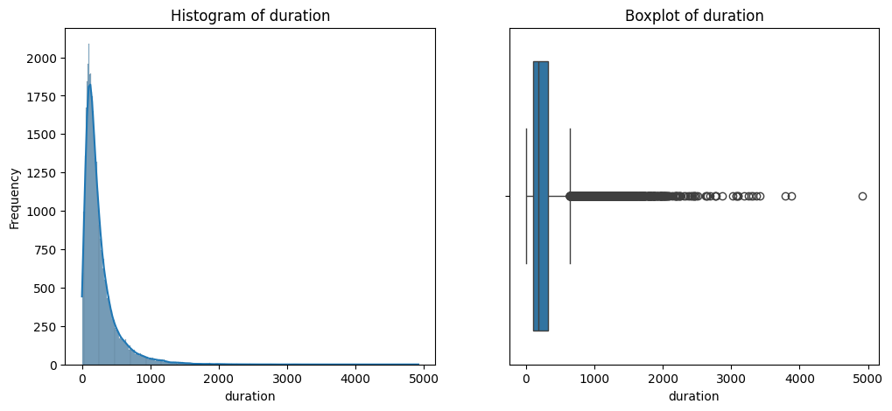
Duration distribution
Notes:
The key impressions and findings for each numeric variable:
age: The average age is around 40.9 years, with a standard deviation of 10.6. Ages range from 18 to 95. The median (39) is close to the mean, suggesting a relatively symmetrical distribution with a slight right skew, as 75% of the data is below 48.
balance: This variable shows a wide range from -8019 to 102127, indicating that some clients have negative balances (overdrafts) and a few have extremely high balances. The mean balance is 1362, but the median is much lower at 448.5, and the standard deviation is very high (3044.78). This confirms a strong right-skewed distribution, with most clients having lower balances and a few outliers with very large balances.
day: The average day of contact is around the 15th or 16th of the month. The distribution seems fairly uniform across the month, with a range from day 1 to 31.
duration: The average contact duration is about 258 seconds (around 4.3 minutes), but the standard deviation is almost as large as the mean (257.5), and the median is 180 seconds. The maximum duration is 4918 seconds (over 81 minutes). This suggests a heavily right-skewed distribution, with most contacts being short and a few being very long.
campaign: On average, clients are contacted 2.76 times. The minimum is 1 contact and the maximum is 63. The median is 2. The distribution is highly right-skewed, indicating that most clients are contacted only a few times, while a small number are contacted many times.
pdays: The mean pdays is about 40.2, but the median is -1. The value -1 typically signifies that the client was not previously contacted. A large portion of the data is concentrated at -1, with the remaining positive values ranging up to 871. This variable is heavily skewed towards -1, with a long tail for clients who were contacted in previous campaigns.
previous: The average number of previous contacts is very low (0.58), with a median of 0. The maximum is 275. This variable is also highly right-skewed, showing that most clients have had no previous contacts, and a few have had many.
In summary, balance, duration, campaign, pdays, and previous all exhibit strong positive skewness, indicating the presence of outliers or a distribution where a large number of observations are concentrated at the lower end, with a few extreme values at the higher end. Age is relatively more symmetrical but still slightly right-skewed, while day appears to be more uniformly distributed.

Slide 13
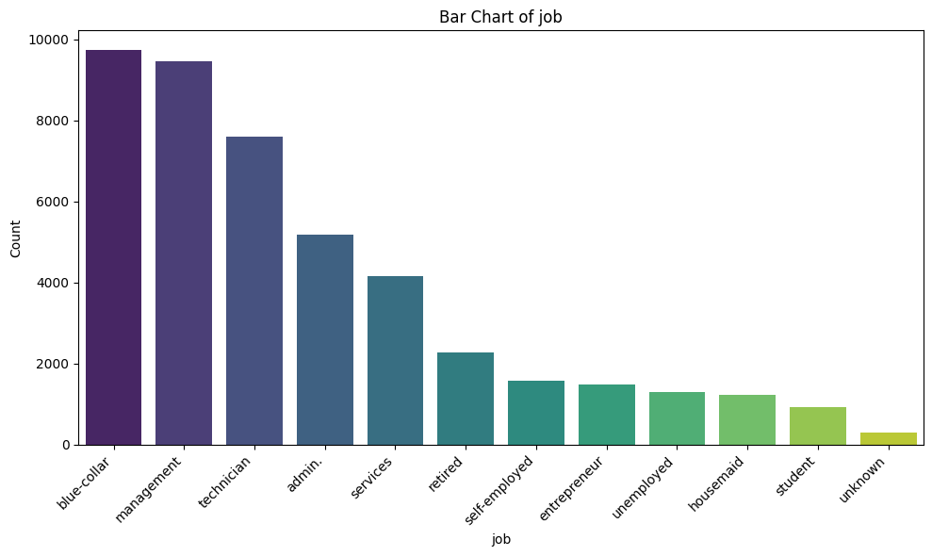
Job distribution
Notes:
The key impressions and findings for each numeric variable:
age: The average age is around 40.9 years, with a standard deviation of 10.6. Ages range from 18 to 95. The median (39) is close to the mean, suggesting a relatively symmetrical distribution with a slight right skew, as 75% of the data is below 48.
balance: This variable shows a wide range from -8019 to 102127, indicating that some clients have negative balances (overdrafts) and a few have extremely high balances. The mean balance is 1362, but the median is much lower at 448.5, and the standard deviation is very high (3044.78). This confirms a strong right-skewed distribution, with most clients having lower balances and a few outliers with very large balances.
day: The average day of contact is around the 15th or 16th of the month. The distribution seems fairly uniform across the month, with a range from day 1 to 31.
duration: The average contact duration is about 258 seconds (around 4.3 minutes), but the standard deviation is almost as large as the mean (257.5), and the median is 180 seconds. The maximum duration is 4918 seconds (over 81 minutes). This suggests a heavily right-skewed distribution, with most contacts being short and a few being very long.
campaign: On average, clients are contacted 2.76 times. The minimum is 1 contact and the maximum is 63. The median is 2. The distribution is highly right-skewed, indicating that most clients are contacted only a few times, while a small number are contacted many times.
pdays: The mean pdays is about 40.2, but the median is -1. The value -1 typically signifies that the client was not previously contacted. A large portion of the data is concentrated at -1, with the remaining positive values ranging up to 871. This variable is heavily skewed towards -1, with a long tail for clients who were contacted in previous campaigns.
previous: The average number of previous contacts is very low (0.58), with a median of 0. The maximum is 275. This variable is also highly right-skewed, showing that most clients have had no previous contacts, and a few have had many.
In summary, balance, duration, campaign, pdays, and previous all exhibit strong positive skewness, indicating the presence of outliers or a distribution where a large number of observations are concentrated at the lower end, with a few extreme values at the higher end. Age is relatively more symmetrical but still slightly right-skewed, while day appears to be more uniformly distributed.

Slide 14
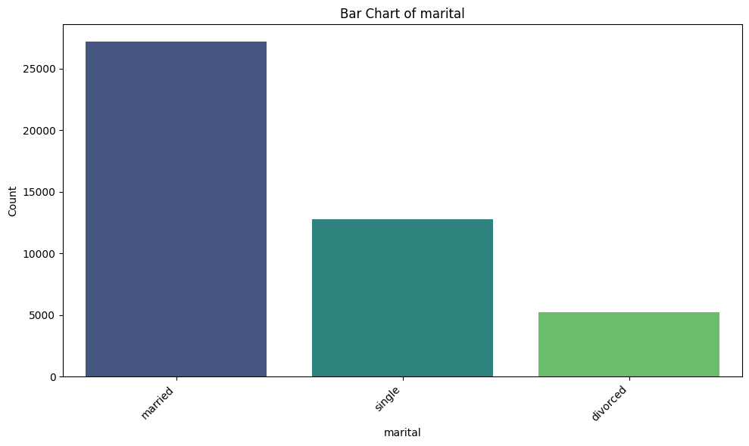
Marital distribution
Notes:
The key impressions and findings for each numeric variable:
age: The average age is around 40.9 years, with a standard deviation of 10.6. Ages range from 18 to 95. The median (39) is close to the mean, suggesting a relatively symmetrical distribution with a slight right skew, as 75% of the data is below 48.
balance: This variable shows a wide range from -8019 to 102127, indicating that some clients have negative balances (overdrafts) and a few have extremely high balances. The mean balance is 1362, but the median is much lower at 448.5, and the standard deviation is very high (3044.78). This confirms a strong right-skewed distribution, with most clients having lower balances and a few outliers with very large balances.
day: The average day of contact is around the 15th or 16th of the month. The distribution seems fairly uniform across the month, with a range from day 1 to 31.
duration: The average contact duration is about 258 seconds (around 4.3 minutes), but the standard deviation is almost as large as the mean (257.5), and the median is 180 seconds. The maximum duration is 4918 seconds (over 81 minutes). This suggests a heavily right-skewed distribution, with most contacts being short and a few being very long.
campaign: On average, clients are contacted 2.76 times. The minimum is 1 contact and the maximum is 63. The median is 2. The distribution is highly right-skewed, indicating that most clients are contacted only a few times, while a small number are contacted many times.
pdays: The mean pdays is about 40.2, but the median is -1. The value -1 typically signifies that the client was not previously contacted. A large portion of the data is concentrated at -1, with the remaining positive values ranging up to 871. This variable is heavily skewed towards -1, with a long tail for clients who were contacted in previous campaigns.
previous: The average number of previous contacts is very low (0.58), with a median of 0. The maximum is 275. This variable is also highly right-skewed, showing that most clients have had no previous contacts, and a few have had many.
In summary, balance, duration, campaign, pdays, and previous all exhibit strong positive skewness, indicating the presence of outliers or a distribution where a large number of observations are concentrated at the lower end, with a few extreme values at the higher end. Age is relatively more symmetrical but still slightly right-skewed, while day appears to be more uniformly distributed.

Slide 15
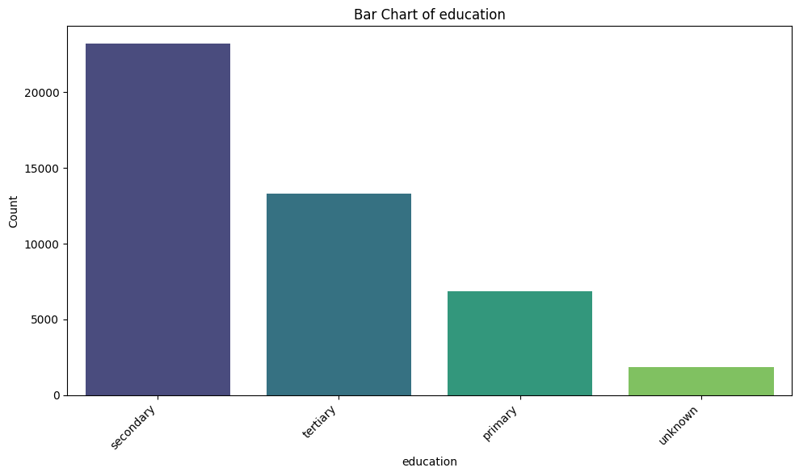
Education distribution
Notes:
The key impressions and findings for each numeric variable:
age: The average age is around 40.9 years, with a standard deviation of 10.6. Ages range from 18 to 95. The median (39) is close to the mean, suggesting a relatively symmetrical distribution with a slight right skew, as 75% of the data is below 48.
balance: This variable shows a wide range from -8019 to 102127, indicating that some clients have negative balances (overdrafts) and a few have extremely high balances. The mean balance is 1362, but the median is much lower at 448.5, and the standard deviation is very high (3044.78). This confirms a strong right-skewed distribution, with most clients having lower balances and a few outliers with very large balances.
day: The average day of contact is around the 15th or 16th of the month. The distribution seems fairly uniform across the month, with a range from day 1 to 31.
duration: The average contact duration is about 258 seconds (around 4.3 minutes), but the standard deviation is almost as large as the mean (257.5), and the median is 180 seconds. The maximum duration is 4918 seconds (over 81 minutes). This suggests a heavily right-skewed distribution, with most contacts being short and a few being very long.
campaign: On average, clients are contacted 2.76 times. The minimum is 1 contact and the maximum is 63. The median is 2. The distribution is highly right-skewed, indicating that most clients are contacted only a few times, while a small number are contacted many times.
pdays: The mean pdays is about 40.2, but the median is -1. The value -1 typically signifies that the client was not previously contacted. A large portion of the data is concentrated at -1, with the remaining positive values ranging up to 871. This variable is heavily skewed towards -1, with a long tail for clients who were contacted in previous campaigns.
previous: The average number of previous contacts is very low (0.58), with a median of 0. The maximum is 275. This variable is also highly right-skewed, showing that most clients have had no previous contacts, and a few have had many.
In summary, balance, duration, campaign, pdays, and previous all exhibit strong positive skewness, indicating the presence of outliers or a distribution where a large number of observations are concentrated at the lower end, with a few extreme values at the higher end. Age is relatively more symmetrical but still slightly right-skewed, while day appears to be more uniformly distributed.

Slide 16
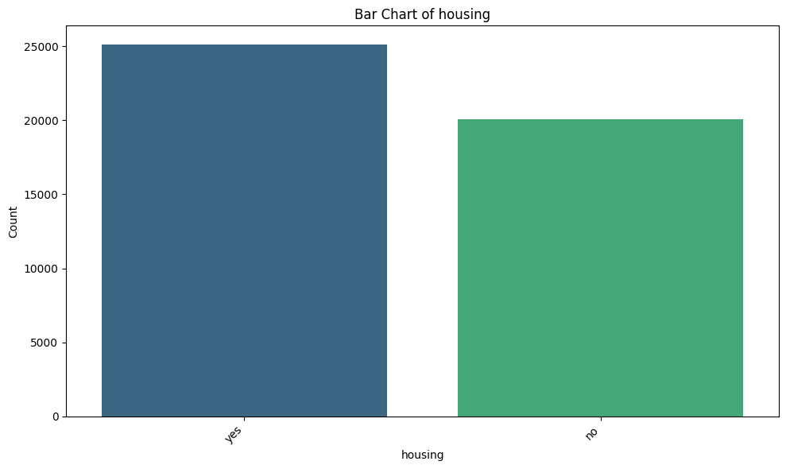
Housing distribution
Notes:
The key impressions and findings for each numeric variable:
age: The average age is around 40.9 years, with a standard deviation of 10.6. Ages range from 18 to 95. The median (39) is close to the mean, suggesting a relatively symmetrical distribution with a slight right skew, as 75% of the data is below 48.
balance: This variable shows a wide range from -8019 to 102127, indicating that some clients have negative balances (overdrafts) and a few have extremely high balances. The mean balance is 1362, but the median is much lower at 448.5, and the standard deviation is very high (3044.78). This confirms a strong right-skewed distribution, with most clients having lower balances and a few outliers with very large balances.
day: The average day of contact is around the 15th or 16th of the month. The distribution seems fairly uniform across the month, with a range from day 1 to 31.
duration: The average contact duration is about 258 seconds (around 4.3 minutes), but the standard deviation is almost as large as the mean (257.5), and the median is 180 seconds. The maximum duration is 4918 seconds (over 81 minutes). This suggests a heavily right-skewed distribution, with most contacts being short and a few being very long.
campaign: On average, clients are contacted 2.76 times. The minimum is 1 contact and the maximum is 63. The median is 2. The distribution is highly right-skewed, indicating that most clients are contacted only a few times, while a small number are contacted many times.
pdays: The mean pdays is about 40.2, but the median is -1. The value -1 typically signifies that the client was not previously contacted. A large portion of the data is concentrated at -1, with the remaining positive values ranging up to 871. This variable is heavily skewed towards -1, with a long tail for clients who were contacted in previous campaigns.
previous: The average number of previous contacts is very low (0.58), with a median of 0. The maximum is 275. This variable is also highly right-skewed, showing that most clients have had no previous contacts, and a few have had many.
In summary, balance, duration, campaign, pdays, and previous all exhibit strong positive skewness, indicating the presence of outliers or a distribution where a large number of observations are concentrated at the lower end, with a few extreme values at the higher end. Age is relatively more symmetrical but still slightly right-skewed, while day appears to be more uniformly distributed.

Slide 17
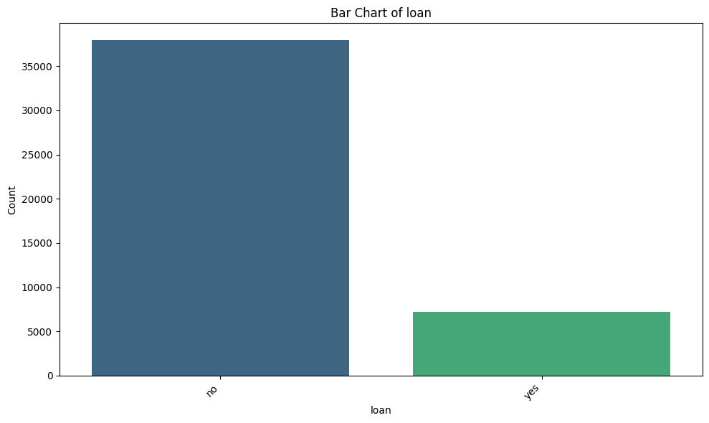
Loan distribution
Notes:
The key impressions and findings for each numeric variable:
age: The average age is around 40.9 years, with a standard deviation of 10.6. Ages range from 18 to 95. The median (39) is close to the mean, suggesting a relatively symmetrical distribution with a slight right skew, as 75% of the data is below 48.
balance: This variable shows a wide range from -8019 to 102127, indicating that some clients have negative balances (overdrafts) and a few have extremely high balances. The mean balance is 1362, but the median is much lower at 448.5, and the standard deviation is very high (3044.78). This confirms a strong right-skewed distribution, with most clients having lower balances and a few outliers with very large balances.
day: The average day of contact is around the 15th or 16th of the month. The distribution seems fairly uniform across the month, with a range from day 1 to 31.
duration: The average contact duration is about 258 seconds (around 4.3 minutes), but the standard deviation is almost as large as the mean (257.5), and the median is 180 seconds. The maximum duration is 4918 seconds (over 81 minutes). This suggests a heavily right-skewed distribution, with most contacts being short and a few being very long.
campaign: On average, clients are contacted 2.76 times. The minimum is 1 contact and the maximum is 63. The median is 2. The distribution is highly right-skewed, indicating that most clients are contacted only a few times, while a small number are contacted many times.
pdays: The mean pdays is about 40.2, but the median is -1. The value -1 typically signifies that the client was not previously contacted. A large portion of the data is concentrated at -1, with the remaining positive values ranging up to 871. This variable is heavily skewed towards -1, with a long tail for clients who were contacted in previous campaigns.
previous: The average number of previous contacts is very low (0.58), with a median of 0. The maximum is 275. This variable is also highly right-skewed, showing that most clients have had no previous contacts, and a few have had many.
In summary, balance, duration, campaign, pdays, and previous all exhibit strong positive skewness, indicating the presence of outliers or a distribution where a large number of observations are concentrated at the lower end, with a few extreme values at the higher end. Age is relatively more symmetrical but still slightly right-skewed, while day appears to be more uniformly distributed.

Slide 18
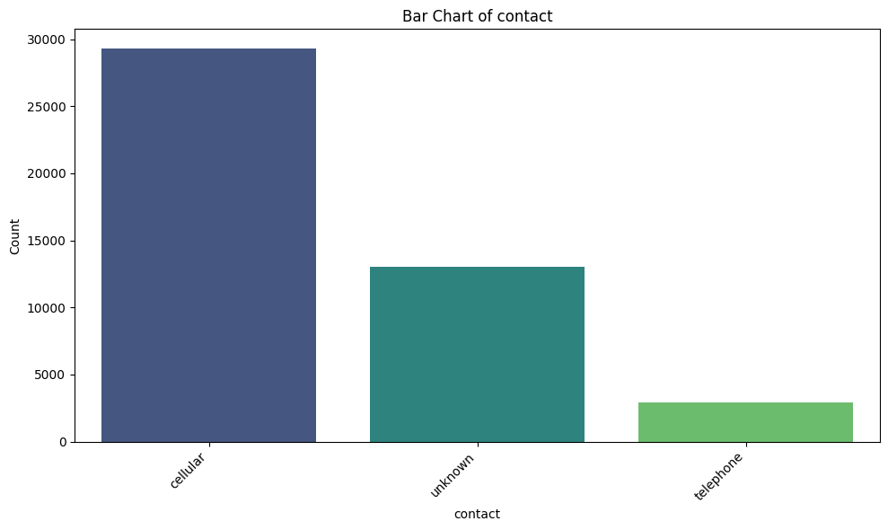
Contact distribution
Notes:
The key impressions and findings for each numeric variable:
age: The average age is around 40.9 years, with a standard deviation of 10.6. Ages range from 18 to 95. The median (39) is close to the mean, suggesting a relatively symmetrical distribution with a slight right skew, as 75% of the data is below 48.
balance: This variable shows a wide range from -8019 to 102127, indicating that some clients have negative balances (overdrafts) and a few have extremely high balances. The mean balance is 1362, but the median is much lower at 448.5, and the standard deviation is very high (3044.78). This confirms a strong right-skewed distribution, with most clients having lower balances and a few outliers with very large balances.
day: The average day of contact is around the 15th or 16th of the month. The distribution seems fairly uniform across the month, with a range from day 1 to 31.
duration: The average contact duration is about 258 seconds (around 4.3 minutes), but the standard deviation is almost as large as the mean (257.5), and the median is 180 seconds. The maximum duration is 4918 seconds (over 81 minutes). This suggests a heavily right-skewed distribution, with most contacts being short and a few being very long.
campaign: On average, clients are contacted 2.76 times. The minimum is 1 contact and the maximum is 63. The median is 2. The distribution is highly right-skewed, indicating that most clients are contacted only a few times, while a small number are contacted many times.
pdays: The mean pdays is about 40.2, but the median is -1. The value -1 typically signifies that the client was not previously contacted. A large portion of the data is concentrated at -1, with the remaining positive values ranging up to 871. This variable is heavily skewed towards -1, with a long tail for clients who were contacted in previous campaigns.
previous: The average number of previous contacts is very low (0.58), with a median of 0. The maximum is 275. This variable is also highly right-skewed, showing that most clients have had no previous contacts, and a few have had many.
In summary, balance, duration, campaign, pdays, and previous all exhibit strong positive skewness, indicating the presence of outliers or a distribution where a large number of observations are concentrated at the lower end, with a few extreme values at the higher end. Age is relatively more symmetrical but still slightly right-skewed, while day appears to be more uniformly distributed.

Slide 19
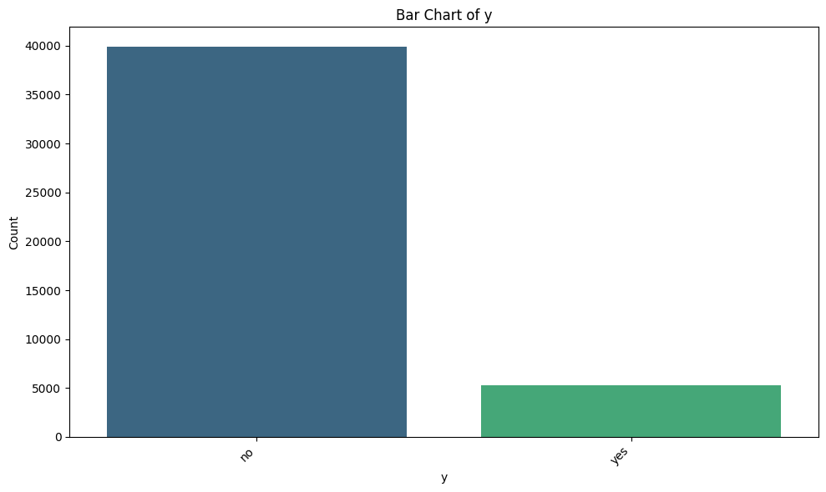
y distribution
Notes:
The key impressions and findings for each numeric variable:
age: The average age is around 40.9 years, with a standard deviation of 10.6. Ages range from 18 to 95. The median (39) is close to the mean, suggesting a relatively symmetrical distribution with a slight right skew, as 75% of the data is below 48.
balance: This variable shows a wide range from -8019 to 102127, indicating that some clients have negative balances (overdrafts) and a few have extremely high balances. The mean balance is 1362, but the median is much lower at 448.5, and the standard deviation is very high (3044.78). This confirms a strong right-skewed distribution, with most clients having lower balances and a few outliers with very large balances.
day: The average day of contact is around the 15th or 16th of the month. The distribution seems fairly uniform across the month, with a range from day 1 to 31.
duration: The average contact duration is about 258 seconds (around 4.3 minutes), but the standard deviation is almost as large as the mean (257.5), and the median is 180 seconds. The maximum duration is 4918 seconds (over 81 minutes). This suggests a heavily right-skewed distribution, with most contacts being short and a few being very long.
campaign: On average, clients are contacted 2.76 times. The minimum is 1 contact and the maximum is 63. The median is 2. The distribution is highly right-skewed, indicating that most clients are contacted only a few times, while a small number are contacted many times.
pdays: The mean pdays is about 40.2, but the median is -1. The value -1 typically signifies that the client was not previously contacted. A large portion of the data is concentrated at -1, with the remaining positive values ranging up to 871. This variable is heavily skewed towards -1, with a long tail for clients who were contacted in previous campaigns.
previous: The average number of previous contacts is very low (0.58), with a median of 0. The maximum is 275. This variable is also highly right-skewed, showing that most clients have had no previous contacts, and a few have had many.
In summary, balance, duration, campaign, pdays, and previous all exhibit strong positive skewness, indicating the presence of outliers or a distribution where a large number of observations are concentrated at the lower end, with a few extreme values at the higher end. Age is relatively more symmetrical but still slightly right-skewed, while day appears to be more uniformly distributed.

Slide 20
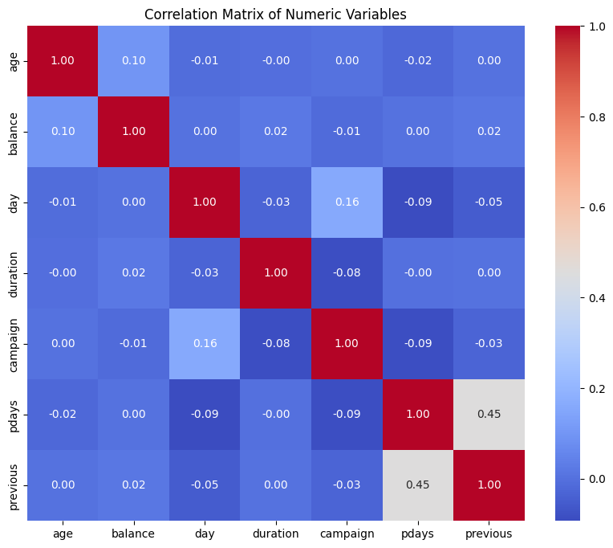
Correlation among numeric variables
Notes:
The key impressions and findings for each numeric variable:
age: The average age is around 40.9 years, with a standard deviation of 10.6. Ages range from 18 to 95. The median (39) is close to the mean, suggesting a relatively symmetrical distribution with a slight right skew, as 75% of the data is below 48.
balance: This variable shows a wide range from -8019 to 102127, indicating that some clients have negative balances (overdrafts) and a few have extremely high balances. The mean balance is 1362, but the median is much lower at 448.5, and the standard deviation is very high (3044.78). This confirms a strong right-skewed distribution, with most clients having lower balances and a few outliers with very large balances.
day: The average day of contact is around the 15th or 16th of the month. The distribution seems fairly uniform across the month, with a range from day 1 to 31.
duration: The average contact duration is about 258 seconds (around 4.3 minutes), but the standard deviation is almost as large as the mean (257.5), and the median is 180 seconds. The maximum duration is 4918 seconds (over 81 minutes). This suggests a heavily right-skewed distribution, with most contacts being short and a few being very long.
campaign: On average, clients are contacted 2.76 times. The minimum is 1 contact and the maximum is 63. The median is 2. The distribution is highly right-skewed, indicating that most clients are contacted only a few times, while a small number are contacted many times.
pdays: The mean pdays is about 40.2, but the median is -1. The value -1 typically signifies that the client was not previously contacted. A large portion of the data is concentrated at -1, with the remaining positive values ranging up to 871. This variable is heavily skewed towards -1, with a long tail for clients who were contacted in previous campaigns.
previous: The average number of previous contacts is very low (0.58), with a median of 0. The maximum is 275. This variable is also highly right-skewed, showing that most clients have had no previous contacts, and a few have had many.
In summary, balance, duration, campaign, pdays, and previous all exhibit strong positive skewness, indicating the presence of outliers or a distribution where a large number of observations are concentrated at the lower end, with a few extreme values at the higher end. Age is relatively more symmetrical but still slightly right-skewed, while day appears to be more uniformly distributed.

Slide 21
03
Principal Component Analysis (PCA)

Slide 22
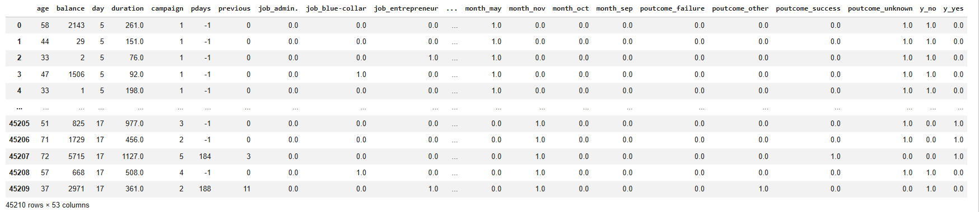
Scaling and Encoding
Notes:
The key impressions and findings for each numeric variable:
age: The average age is around 40.9 years, with a standard deviation of 10.6. Ages range from 18 to 95. The median (39) is close to the mean, suggesting a relatively symmetrical distribution with a slight right skew, as 75% of the data is below 48.
balance: This variable shows a wide range from -8019 to 102127, indicating that some clients have negative balances (overdrafts) and a few have extremely high balances. The mean balance is 1362, but the median is much lower at 448.5, and the standard deviation is very high (3044.78). This confirms a strong right-skewed distribution, with most clients having lower balances and a few outliers with very large balances.
day: The average day of contact is around the 15th or 16th of the month. The distribution seems fairly uniform across the month, with a range from day 1 to 31.
duration: The average contact duration is about 258 seconds (around 4.3 minutes), but the standard deviation is almost as large as the mean (257.5), and the median is 180 seconds. The maximum duration is 4918 seconds (over 81 minutes). This suggests a heavily right-skewed distribution, with most contacts being short and a few being very long.
campaign: On average, clients are contacted 2.76 times. The minimum is 1 contact and the maximum is 63. The median is 2. The distribution is highly right-skewed, indicating that most clients are contacted only a few times, while a small number are contacted many times.
pdays: The mean pdays is about 40.2, but the median is -1. The value -1 typically signifies that the client was not previously contacted. A large portion of the data is concentrated at -1, with the remaining positive values ranging up to 871. This variable is heavily skewed towards -1, with a long tail for clients who were contacted in previous campaigns.
previous: The average number of previous contacts is very low (0.58), with a median of 0. The maximum is 275. This variable is also highly right-skewed, showing that most clients have had no previous contacts, and a few have had many.
In summary, balance, duration, campaign, pdays, and previous all exhibit strong positive skewness, indicating the presence of outliers or a distribution where a large number of observations are concentrated at the lower end, with a few extreme values at the higher end. Age is relatively more symmetrical but still slightly right-skewed, while day appears to be more uniformly distributed.

Slide 23
Scaling and Encoding
Why Scaling and Encoding?
Before applying PCA and Clustering, the data must be prepared so that all variables contribute fairly to the analysis.
Scaling (Numerical Variables)
Numerical variables have different units and range (e.g. age in years, balance in euros, duration in seconds)
Variables with larger values can dominate the analysis
Standardization was applied
Each variable was transformed to have:
Mean = 0
Standard deviation = 1
This ensures that all numerical variables have equal importance.
Notes:
The key impressions and findings for each numeric variable:
age: The average age is around 40.9 years, with a standard deviation of 10.6. Ages range from 18 to 95. The median (39) is close to the mean, suggesting a relatively symmetrical distribution with a slight right skew, as 75% of the data is below 48.
balance: This variable shows a wide range from -8019 to 102127, indicating that some clients have negative balances (overdrafts) and a few have extremely high balances. The mean balance is 1362, but the median is much lower at 448.5, and the standard deviation is very high (3044.78). This confirms a strong right-skewed distribution, with most clients having lower balances and a few outliers with very large balances.
day: The average day of contact is around the 15th or 16th of the month. The distribution seems fairly uniform across the month, with a range from day 1 to 31.
duration: The average contact duration is about 258 seconds (around 4.3 minutes), but the standard deviation is almost as large as the mean (257.5), and the median is 180 seconds. The maximum duration is 4918 seconds (over 81 minutes). This suggests a heavily right-skewed distribution, with most contacts being short and a few being very long.
campaign: On average, clients are contacted 2.76 times. The minimum is 1 contact and the maximum is 63. The median is 2. The distribution is highly right-skewed, indicating that most clients are contacted only a few times, while a small number are contacted many times.
pdays: The mean pdays is about 40.2, but the median is -1. The value -1 typically signifies that the client was not previously contacted. A large portion of the data is concentrated at -1, with the remaining positive values ranging up to 871. This variable is heavily skewed towards -1, with a long tail for clients who were contacted in previous campaigns.
previous: The average number of previous contacts is very low (0.58), with a median of 0. The maximum is 275. This variable is also highly right-skewed, showing that most clients have had no previous contacts, and a few have had many.
In summary, balance, duration, campaign, pdays, and previous all exhibit strong positive skewness, indicating the presence of outliers or a distribution where a large number of observations are concentrated at the lower end, with a few extreme values at the higher end. Age is relatively more symmetrical but still slightly right-skewed, while day appears to be more uniformly distributed.

Slide 24
Scaling and Encoding
Encoding (Categorical Variables)
Machine learning methods cannot work directly with text categories (e.g. job, marital, education)
Categories must be converted into numerical form
Solution:
One-Hot Encoding was used
Each category becomes a binary variable (0 or 1)
This preserves categorical information without introducing false ordering.
Notes:
The key impressions and findings for each numeric variable:
age: The average age is around 40.9 years, with a standard deviation of 10.6. Ages range from 18 to 95. The median (39) is close to the mean, suggesting a relatively symmetrical distribution with a slight right skew, as 75% of the data is below 48.
balance: This variable shows a wide range from -8019 to 102127, indicating that some clients have negative balances (overdrafts) and a few have extremely high balances. The mean balance is 1362, but the median is much lower at 448.5, and the standard deviation is very high (3044.78). This confirms a strong right-skewed distribution, with most clients having lower balances and a few outliers with very large balances.
day: The average day of contact is around the 15th or 16th of the month. The distribution seems fairly uniform across the month, with a range from day 1 to 31.
duration: The average contact duration is about 258 seconds (around 4.3 minutes), but the standard deviation is almost as large as the mean (257.5), and the median is 180 seconds. The maximum duration is 4918 seconds (over 81 minutes). This suggests a heavily right-skewed distribution, with most contacts being short and a few being very long.
campaign: On average, clients are contacted 2.76 times. The minimum is 1 contact and the maximum is 63. The median is 2. The distribution is highly right-skewed, indicating that most clients are contacted only a few times, while a small number are contacted many times.
pdays: The mean pdays is about 40.2, but the median is -1. The value -1 typically signifies that the client was not previously contacted. A large portion of the data is concentrated at -1, with the remaining positive values ranging up to 871. This variable is heavily skewed towards -1, with a long tail for clients who were contacted in previous campaigns.
previous: The average number of previous contacts is very low (0.58), with a median of 0. The maximum is 275. This variable is also highly right-skewed, showing that most clients have had no previous contacts, and a few have had many.
In summary, balance, duration, campaign, pdays, and previous all exhibit strong positive skewness, indicating the presence of outliers or a distribution where a large number of observations are concentrated at the lower end, with a few extreme values at the higher end. Age is relatively more symmetrical but still slightly right-skewed, while day appears to be more uniformly distributed.

Slide 25
Principal Component Analysis (PCA)
Why PCA?
The dataset contains many variables
PCA reduced dimensionality while preserving information
What PCA Does
Transforms original variables into new uncorrelated components
Each component explains a portion of the total variance
PCA simplifies the dataset without significant information loss.
PCA helps summarize complex data into a few meaningful components.
Notes:
The key impressions and findings for each numeric variable:
age: The average age is around 40.9 years, with a standard deviation of 10.6. Ages range from 18 to 95. The median (39) is close to the mean, suggesting a relatively symmetrical distribution with a slight right skew, as 75% of the data is below 48.
balance: This variable shows a wide range from -8019 to 102127, indicating that some clients have negative balances (overdrafts) and a few have extremely high balances. The mean balance is 1362, but the median is much lower at 448.5, and the standard deviation is very high (3044.78). This confirms a strong right-skewed distribution, with most clients having lower balances and a few outliers with very large balances.
day: The average day of contact is around the 15th or 16th of the month. The distribution seems fairly uniform across the month, with a range from day 1 to 31.
duration: The average contact duration is about 258 seconds (around 4.3 minutes), but the standard deviation is almost as large as the mean (257.5), and the median is 180 seconds. The maximum duration is 4918 seconds (over 81 minutes). This suggests a heavily right-skewed distribution, with most contacts being short and a few being very long.
campaign: On average, clients are contacted 2.76 times. The minimum is 1 contact and the maximum is 63. The median is 2. The distribution is highly right-skewed, indicating that most clients are contacted only a few times, while a small number are contacted many times.
pdays: The mean pdays is about 40.2, but the median is -1. The value -1 typically signifies that the client was not previously contacted. A large portion of the data is concentrated at -1, with the remaining positive values ranging up to 871. This variable is heavily skewed towards -1, with a long tail for clients who were contacted in previous campaigns.
previous: The average number of previous contacts is very low (0.58), with a median of 0. The maximum is 275. This variable is also highly right-skewed, showing that most clients have had no previous contacts, and a few have had many.
In summary, balance, duration, campaign, pdays, and previous all exhibit strong positive skewness, indicating the presence of outliers or a distribution where a large number of observations are concentrated at the lower end, with a few extreme values at the higher end. Age is relatively more symmetrical but still slightly right-skewed, while day appears to be more uniformly distributed.

Slide 26
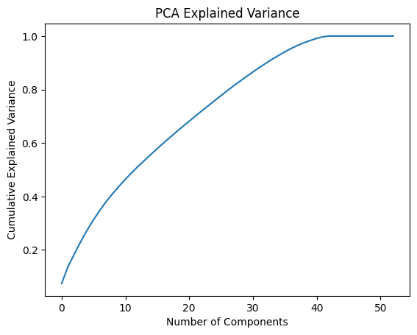
Number of Principal Components
Number of components explaining ≥ 80% variance: K= 28

Slide 27
PCA Interpretation (Components Meaning)
Principal Component 1 (PC1)
Principal Component 2 (PC2)
Represents overall client engagement and financial behavior
Strongly influenced by:
duration
balance
campaign
Represents previous marketing interaction
Influenced by:
pdays
previous
Notes:
The key impressions and findings for each numeric variable:
age: The average age is around 40.9 years, with a standard deviation of 10.6. Ages range from 18 to 95. The median (39) is close to the mean, suggesting a relatively symmetrical distribution with a slight right skew, as 75% of the data is below 48.
balance: This variable shows a wide range from -8019 to 102127, indicating that some clients have negative balances (overdrafts) and a few have extremely high balances. The mean balance is 1362, but the median is much lower at 448.5, and the standard deviation is very high (3044.78). This confirms a strong right-skewed distribution, with most clients having lower balances and a few outliers with very large balances.
day: The average day of contact is around the 15th or 16th of the month. The distribution seems fairly uniform across the month, with a range from day 1 to 31.
duration: The average contact duration is about 258 seconds (around 4.3 minutes), but the standard deviation is almost as large as the mean (257.5), and the median is 180 seconds. The maximum duration is 4918 seconds (over 81 minutes). This suggests a heavily right-skewed distribution, with most contacts being short and a few being very long.
campaign: On average, clients are contacted 2.76 times. The minimum is 1 contact and the maximum is 63. The median is 2. The distribution is highly right-skewed, indicating that most clients are contacted only a few times, while a small number are contacted many times.
pdays: The mean pdays is about 40.2, but the median is -1. The value -1 typically signifies that the client was not previously contacted. A large portion of the data is concentrated at -1, with the remaining positive values ranging up to 871. This variable is heavily skewed towards -1, with a long tail for clients who were contacted in previous campaigns.
previous: The average number of previous contacts is very low (0.58), with a median of 0. The maximum is 275. This variable is also highly right-skewed, showing that most clients have had no previous contacts, and a few have had many.
In summary, balance, duration, campaign, pdays, and previous all exhibit strong positive skewness, indicating the presence of outliers or a distribution where a large number of observations are concentrated at the lower end, with a few extreme values at the higher end. Age is relatively more symmetrical but still slightly right-skewed, while day appears to be more uniformly distributed.

Slide 28
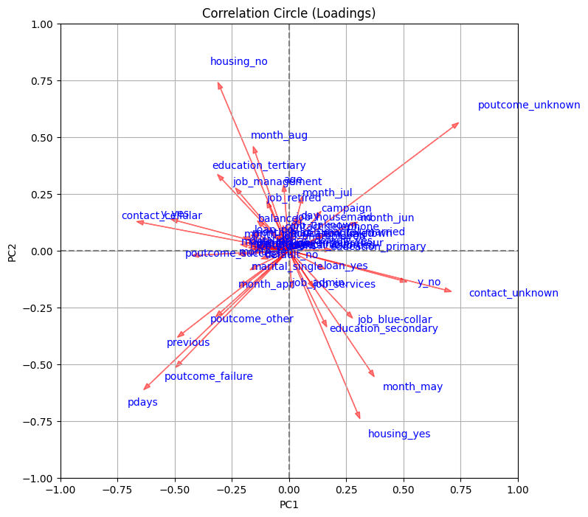
PCA Interpretation (Components Meaning)

Slide 29
Clustering: Why and How?
Why Clustering?
Clustering is an unsupervised method that groups observations into clusters with no prior labels
To group similar observations together
To identify different client profiles
Algorithm Used:
K-Means clustering: K-means is an unsupervised clustering algorithm that groups data into K clusters by minimizing the distance between data points and their cluster centroids(center point of a cluster, calculated as the average position of all data points in that cluster)

Slide 30
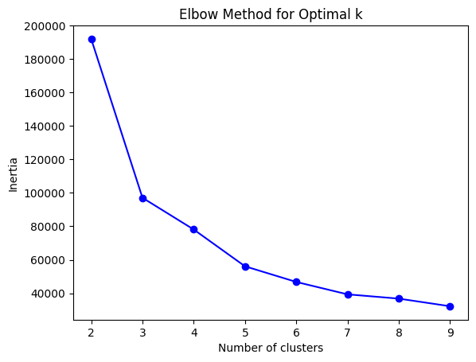
Choosing the Number of Clusters
Elbow Method
Used to find the best number of clusters (K) in clustering (like K-means).
Idea:
Run clustering with different K values.
Plot K vs inertia.
Look for the point where improvement suddenly slows → looks like an elbow.
We notice that from 5, the curve starts to go down slowly (like elbow), which means that the best choice from this graph is 5 clusters.

Slide 31
Choosing the Number of Clusters
Silhouette Score:
Used to measure how good the clustering is.
Range:
+1 → very good clustering (points well matched to their cluster)
0 → clusters overlap
-1 → points probably in wrong cluster
And the Silhouette score of 0.42 means that clustering is reasonable but not perfect.

Slide 32
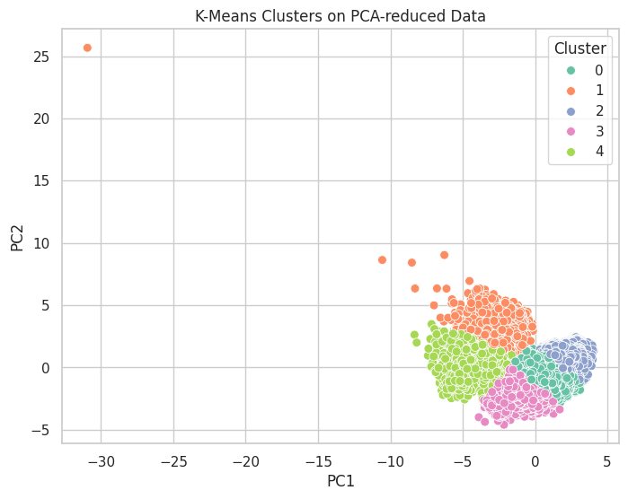
Clustering Method
This plot shows the result of K-means clustering applied to data after PCA reduction.
Each point represents a data sample projected onto the first two principal components (PC1 and PC2), and colors indicate the five clusters found by the model.
The clusters are mostly well separated, showing that K-means was able to group similar data points, although some overlap exists, which explains the moderate silhouette score.

Slide 33
Conclusion
Exploratory analysis provided strong insights
Clear patterns exist between client behavior and subscription
Results can support marketing strategy optimization

